Slide 1
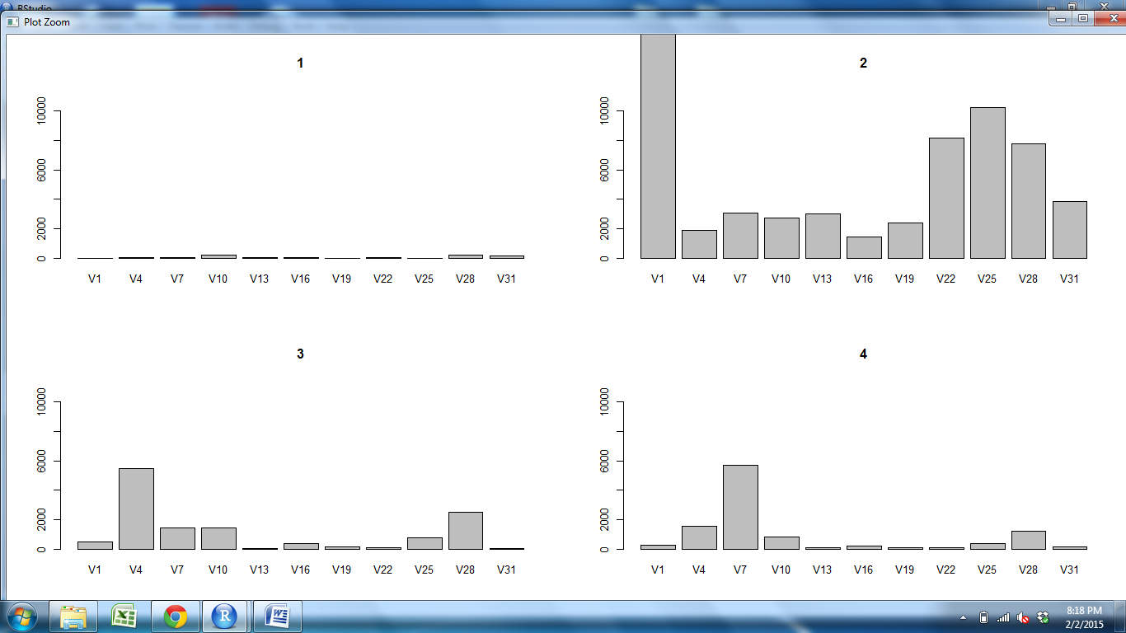
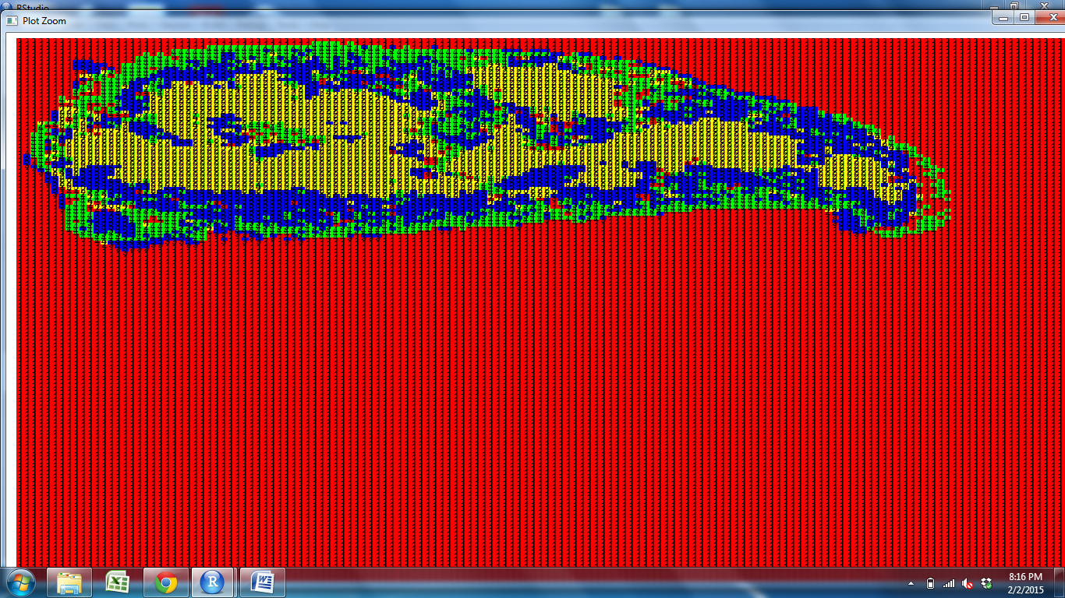
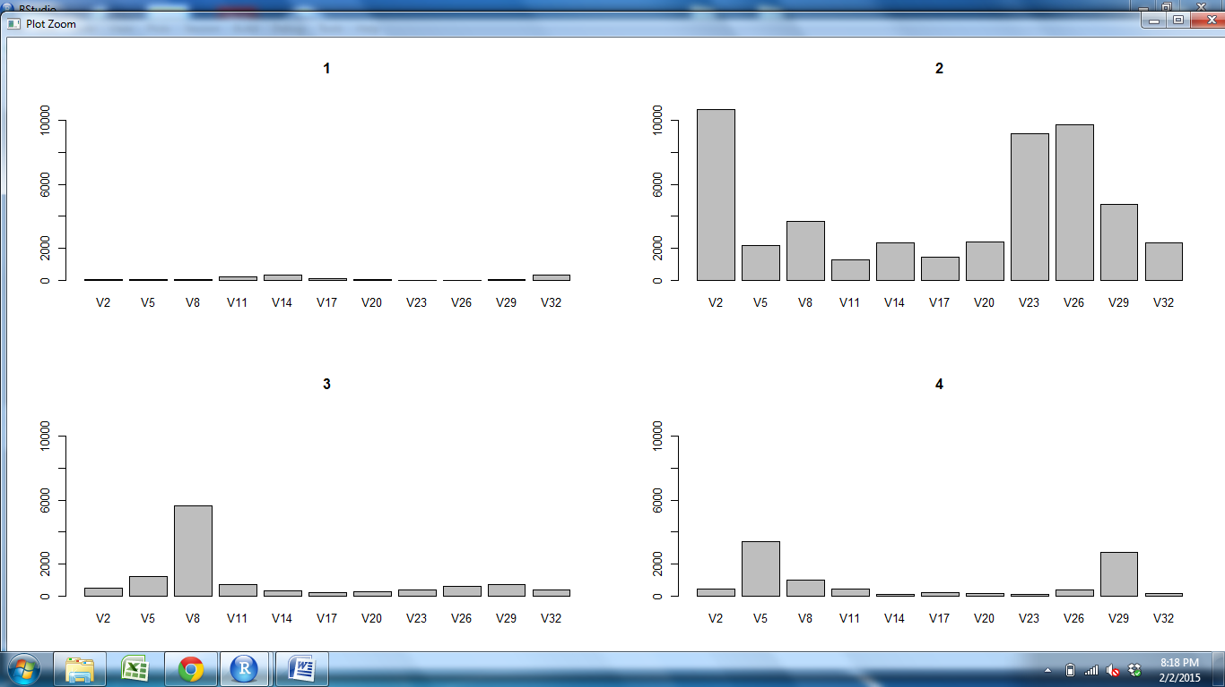
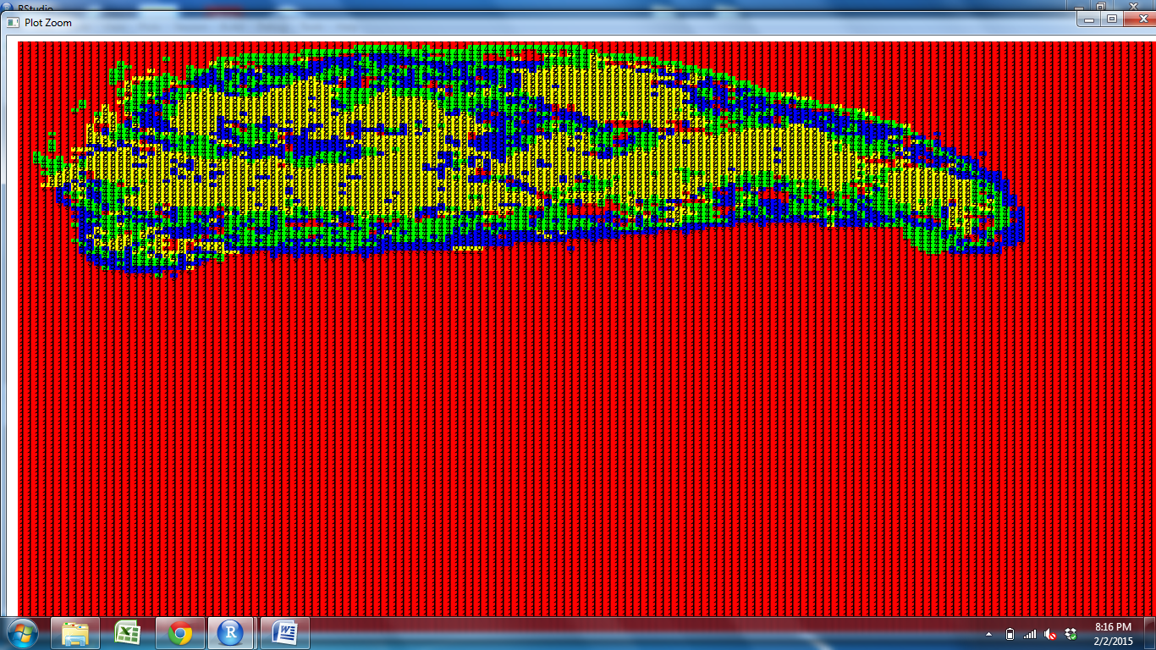
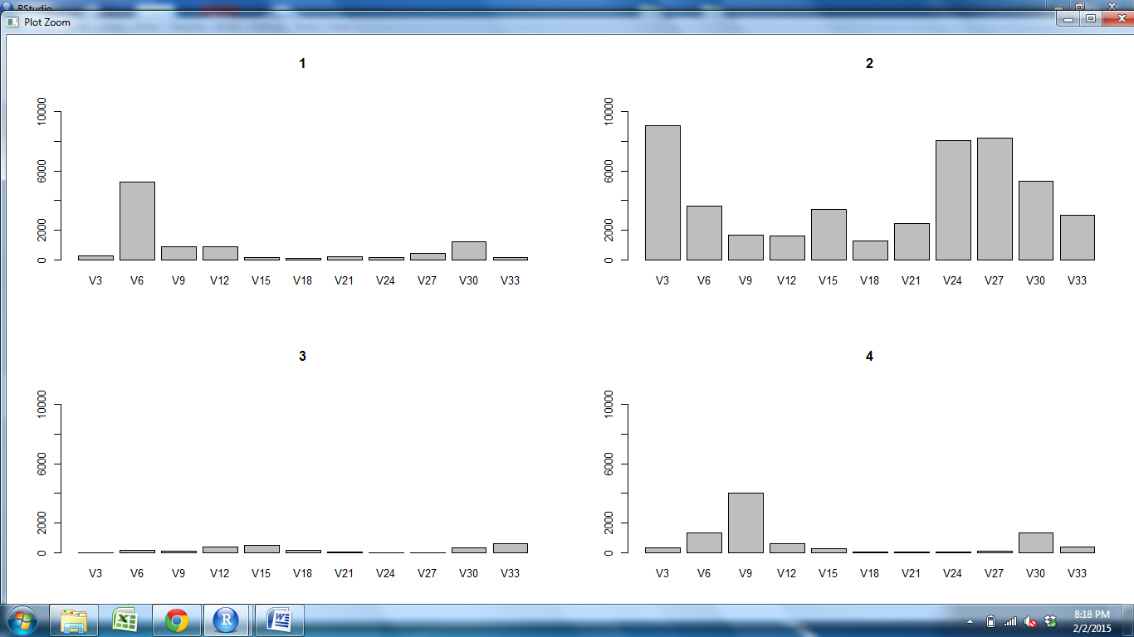
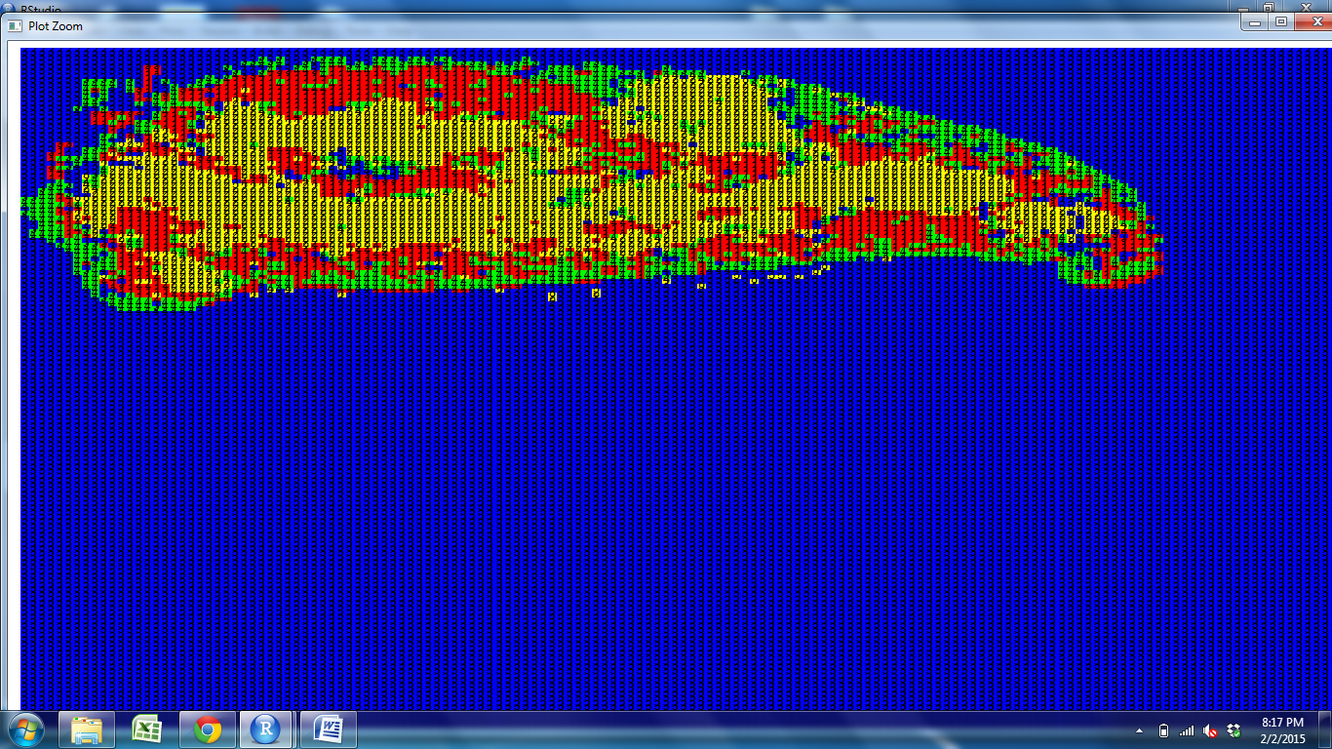
CD11c CD205 CD25 CD31 Claud34 Claud5 Foxp3 K14 K5 PDGFRb UEA1

Slide 2
CD11c CD205 CD25 CD31 Claud34 Claud5 Foxp3 K14 K5 PDGFRb UEA1

Slide 3
CD11c CD205 CD25 CD31 Claud34 Claud5 Foxp3 K14 K5 PDGFRb UEA1

Slide 4
CD11c CD205 CD25 CD31 Claud34 Claud5 Foxp3 K14 K5 PDGFRb UEA1

Slide 5
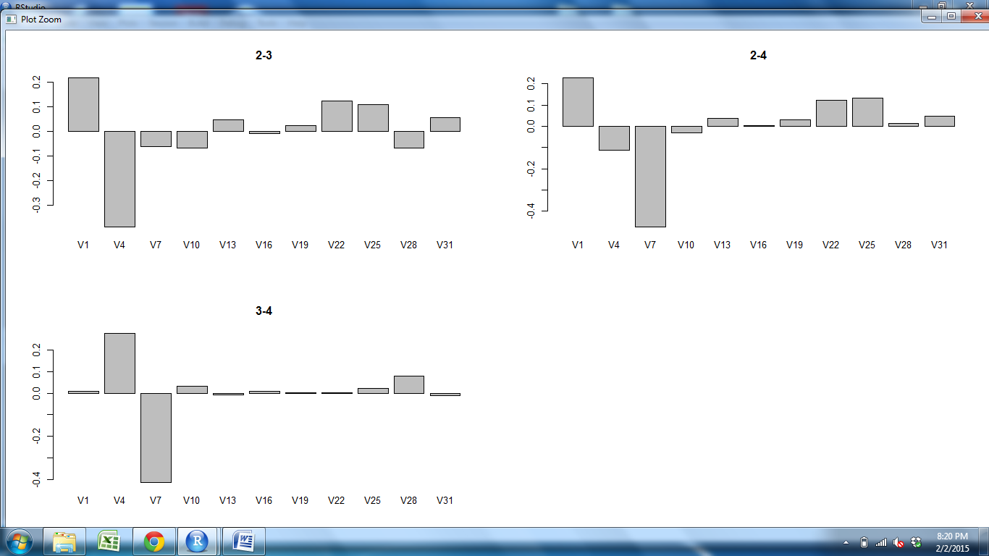
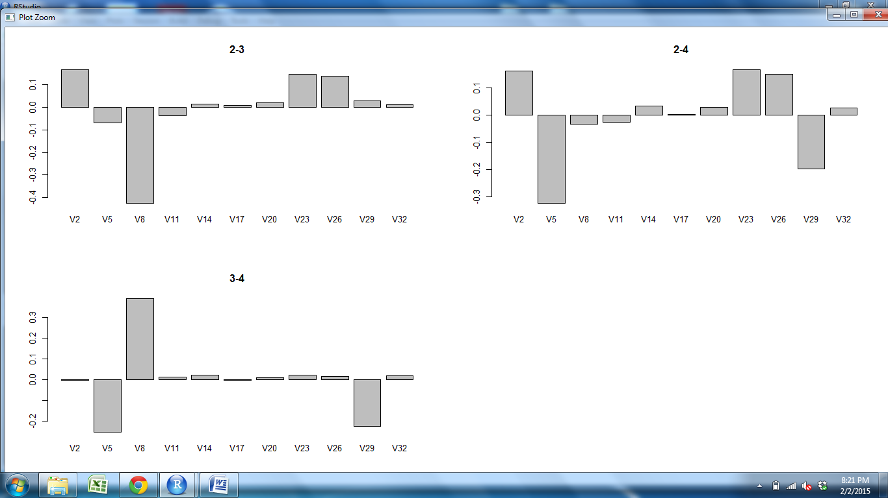
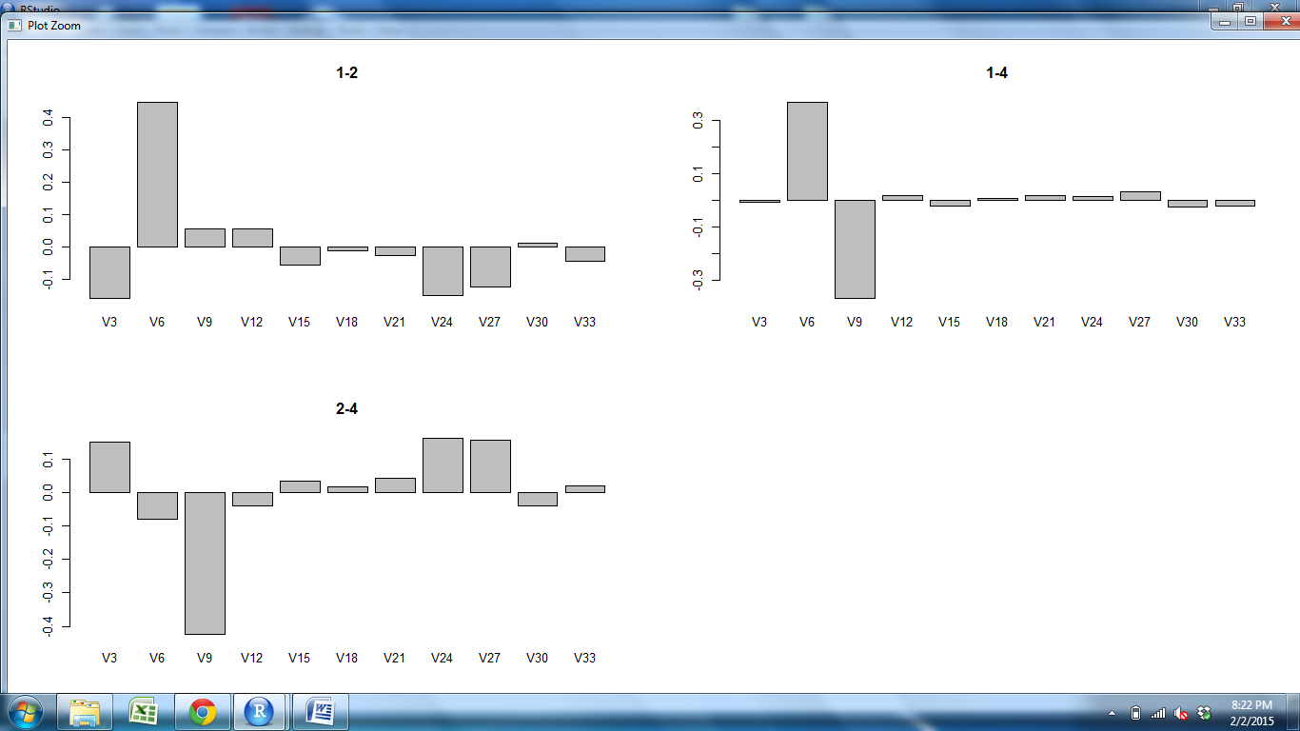
CD11c CD205 CD25 CD31 Claud34 Claud5 Foxp3 K14 K5 PDGFRb UEA1

Slide 6
CD11c CD205 CD25 CD31 Claud34 Claud5 Foxp3 K14 K5 PDGFRb UEA1

Slide 7
CD11c CD205 CD25 CD31 Claud34 Claud5 Foxp3 K14 K5 PDGFRb UEA1

Slide 8
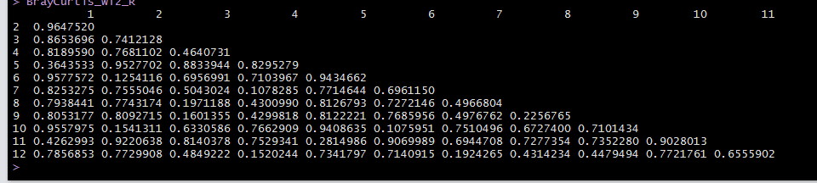
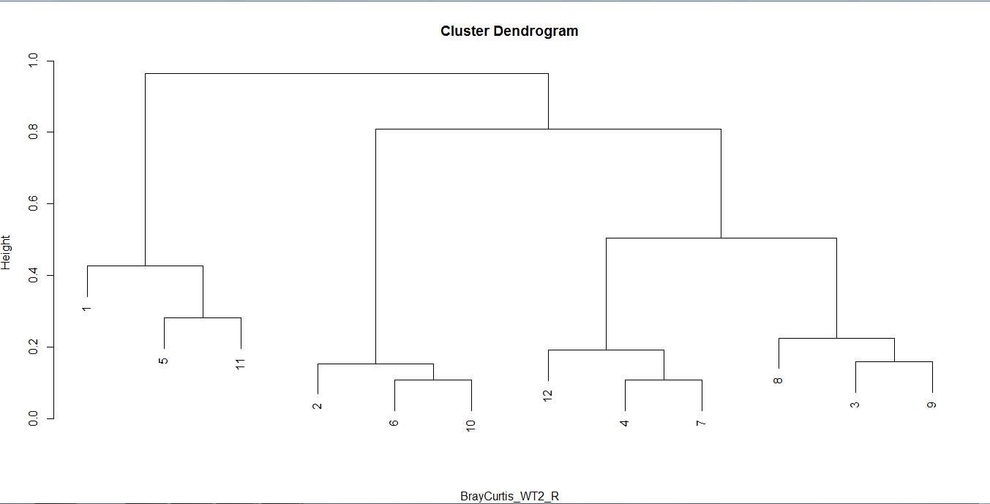
Outer M Cortex Subcap Outer M Subcap Cortex Cortex M Outer
M
Cortex
Subcap
Outer
M
Subcap
Cortex
Cortex
M
Outer
Subcap
S1Outer S2Outer S3Outer S1M S2M S3M S3Subcap S1Subcap S2Subcap S2Cortex S1Cortex S3Cortex

